Slide 1
Capstone Project Update A Scalable and Parallelizable Multi-Agent Reinforcement Learning Framework for Cooperative and Competitive Autonomous Vehicles
AuE-8930 Computing and Simulation for Autonomy
Chinmay Samak
PhD Candidate, CU-ICAR
csamak@clemson.edu
Tanmay Samak
PhD Candidate, CU-ICAR
tsamak@clemson.edu

Slide 2
Project Proposal
Parallelizable Multi-Agent Reinforcement Learning

Slide 3


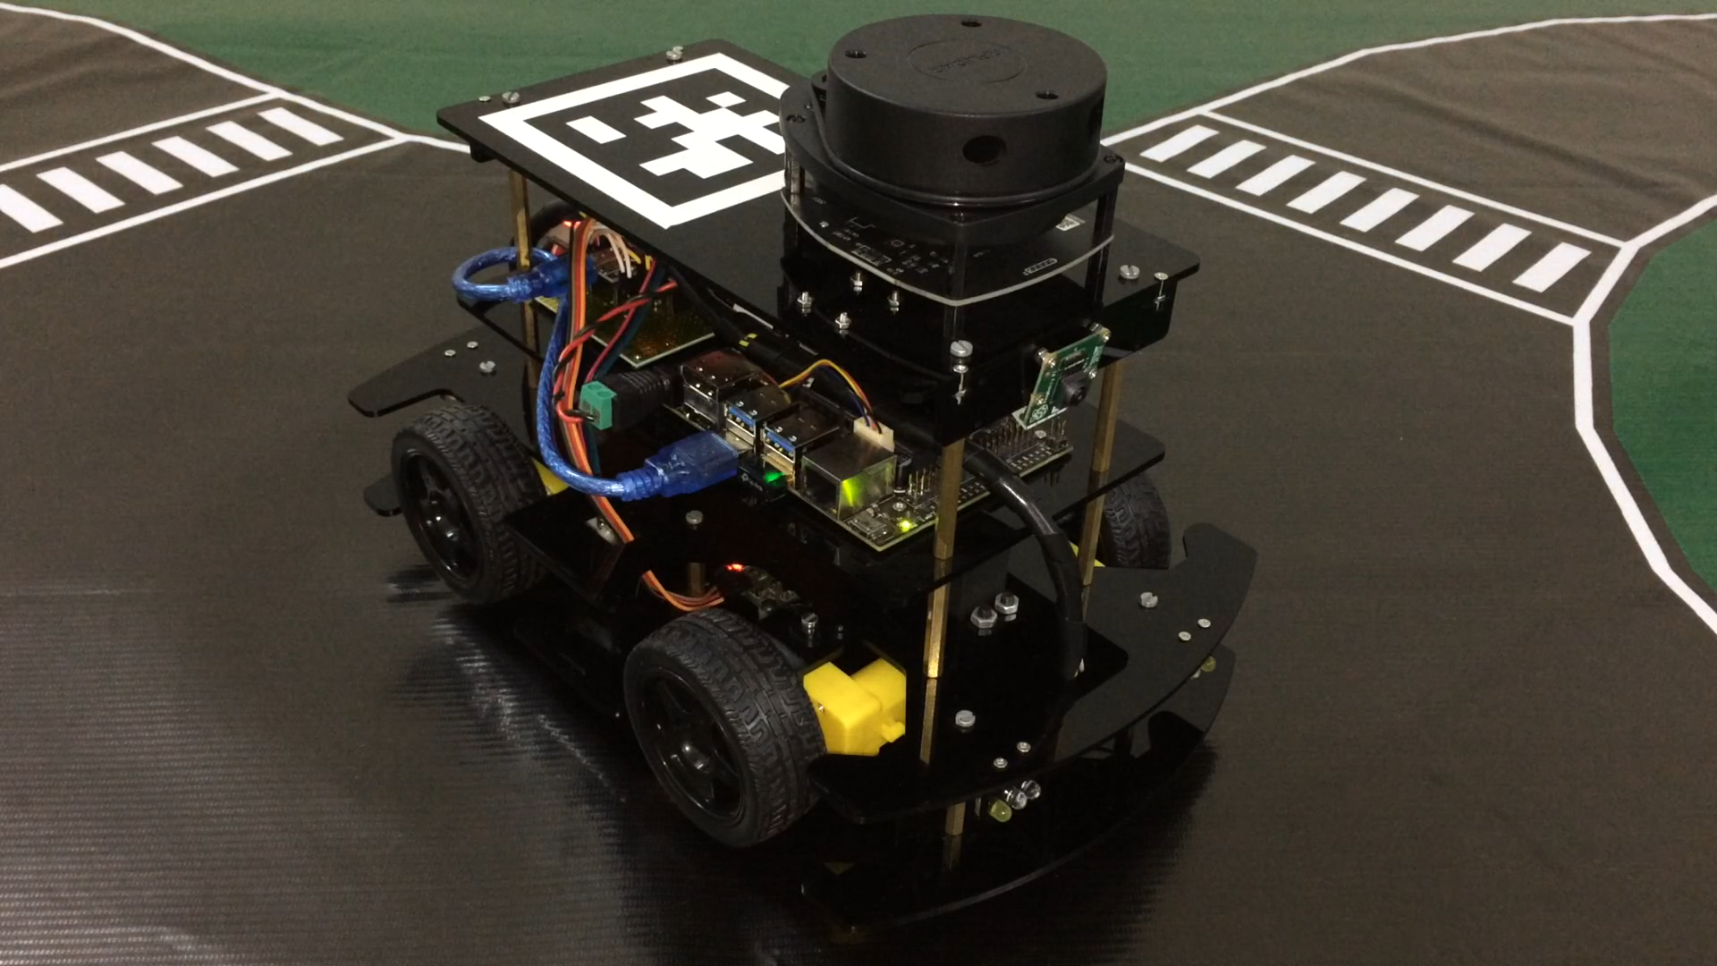
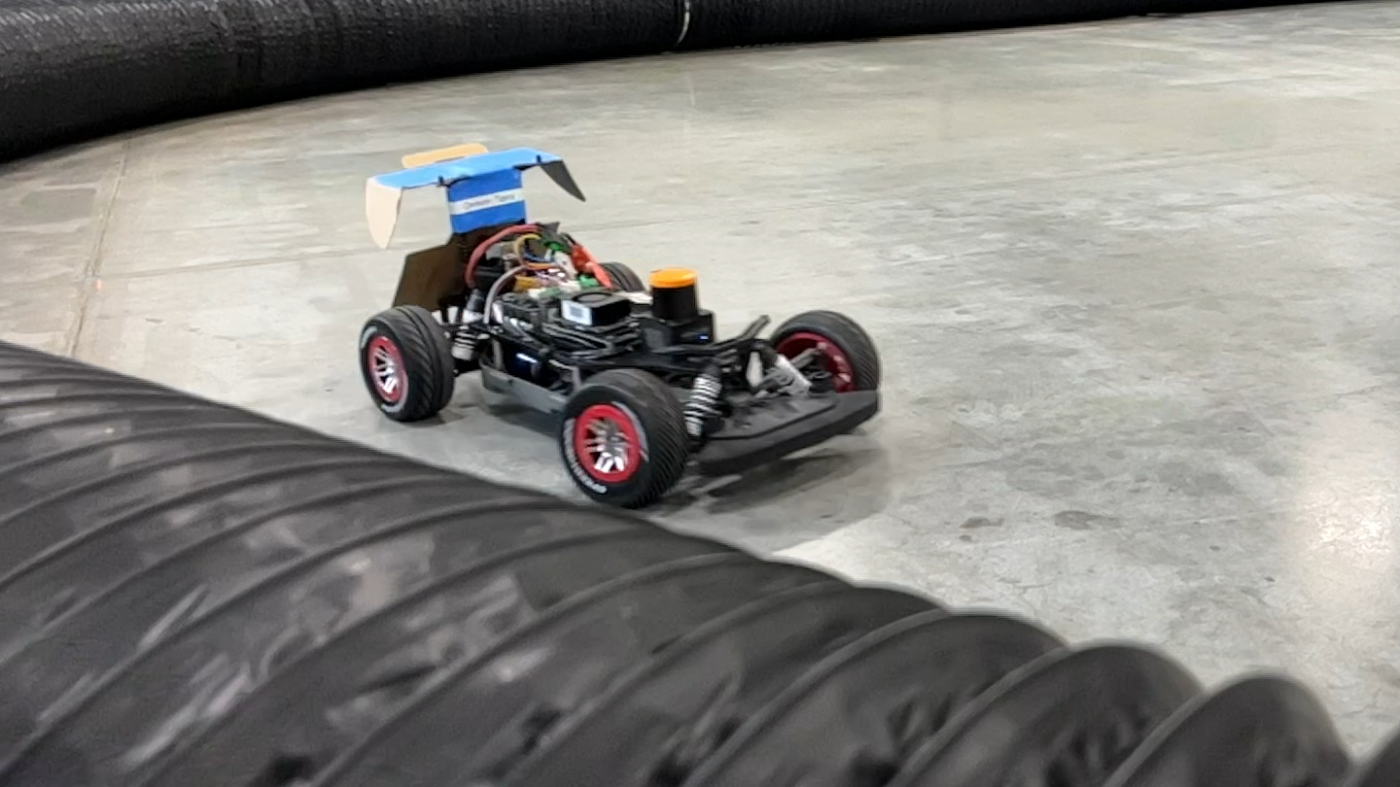
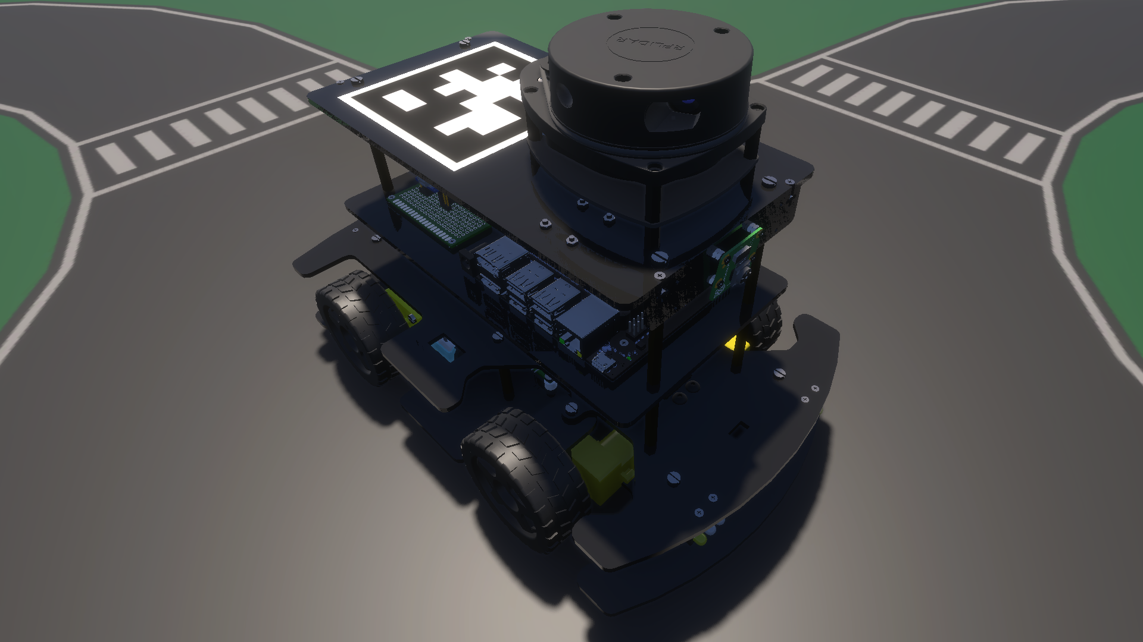
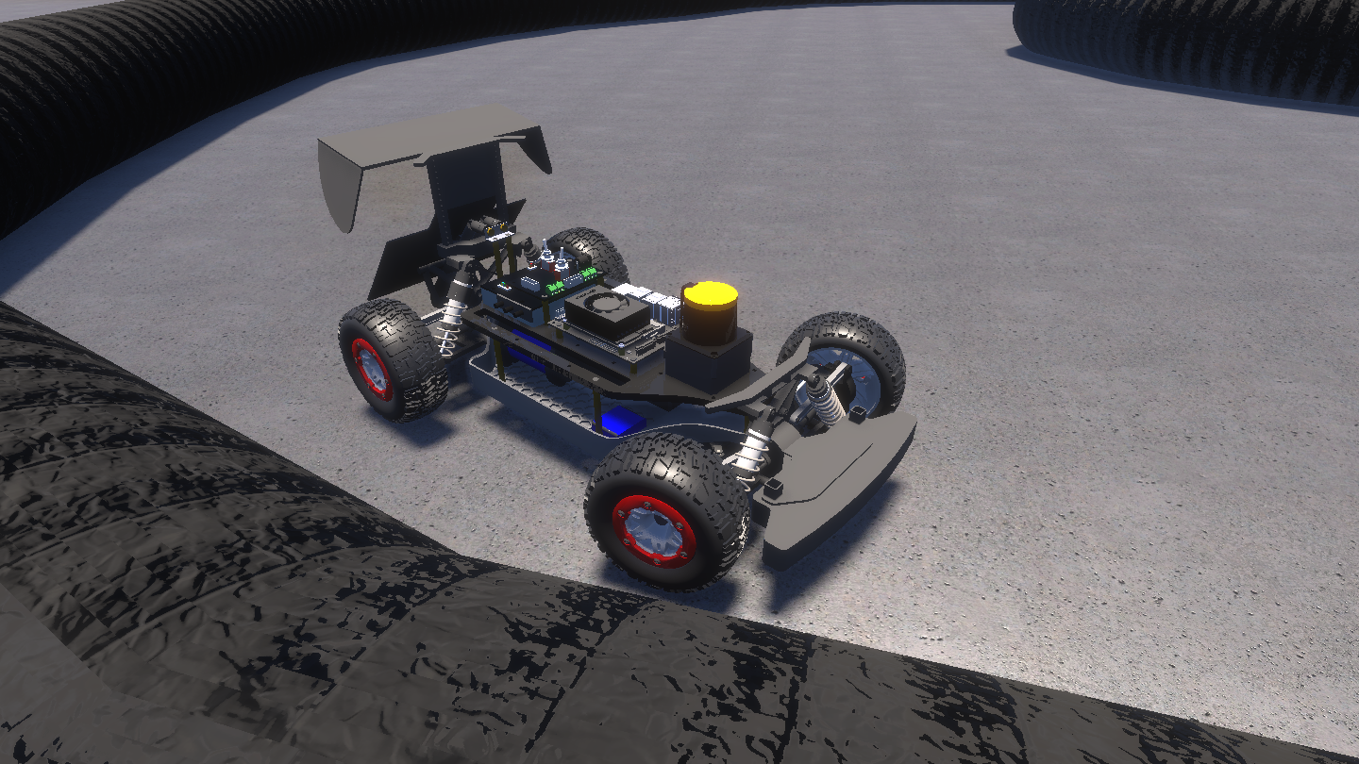
Planned Project Objectives
Set up high-fidelity 3D simulation platform based on real-world vehicle/environment representations (real2sim transfer) [Tanmay]
Set up modular and scalable simulation framework using object oriented programming (OOP) [Chinmay]
Set up intelligent agent/environment parallelization framework for accelerating RL training [Tanmay]
Formulate multi-agent reinforcement learning (MARL) problems for: [Tanmay]
Cooperative MARL (e.g., safe intersection traversal)
Competitive MARL (e.g., head-to-head autonomous racing)
Implement the formulated deep reinforcement learning (DRL) pipeline and conduct parallelized training using local/cloud high-performance computing (HPC) resources [Chinmay]
Deploy and analyze the trained policies and procedures to comment on the aspects of “computing and simulation for autonomy” [Chinmay]
Note: The name in square bracket indicates primary responsibility and NOT contribution. Both members will work together and contribute equally to this project.

Slide 4

Planned Project Objectives
AuE-8930 Capstone Project (Fall 2023)
Task | 10/17 | 10/24 | 10/31 | 11/07 | 11/14 | 11/21 | 11/28 | 12/05
Announcements
Project Proposal
Phase 1
Phase 2
Phase 3
Project Presentation
Project Report

Slide 5
Research Motivation
Parallelizable Multi-Agent Reinforcement Learning for Cooperative and Competitive Autonomy

Slide 6
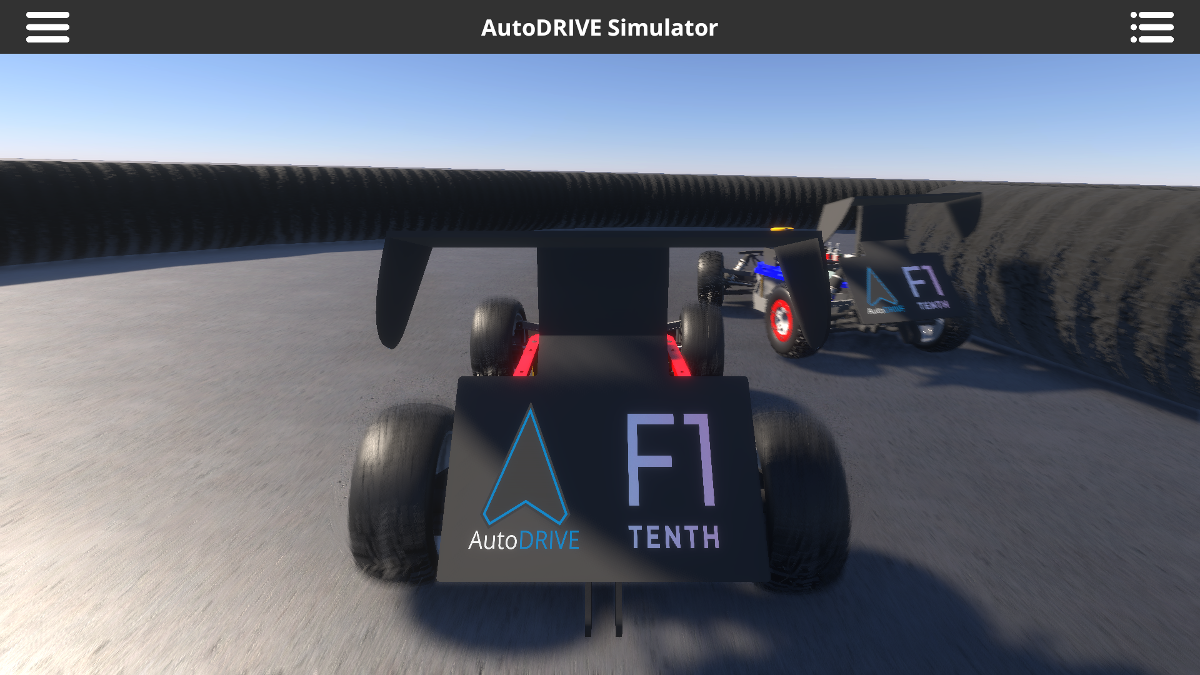
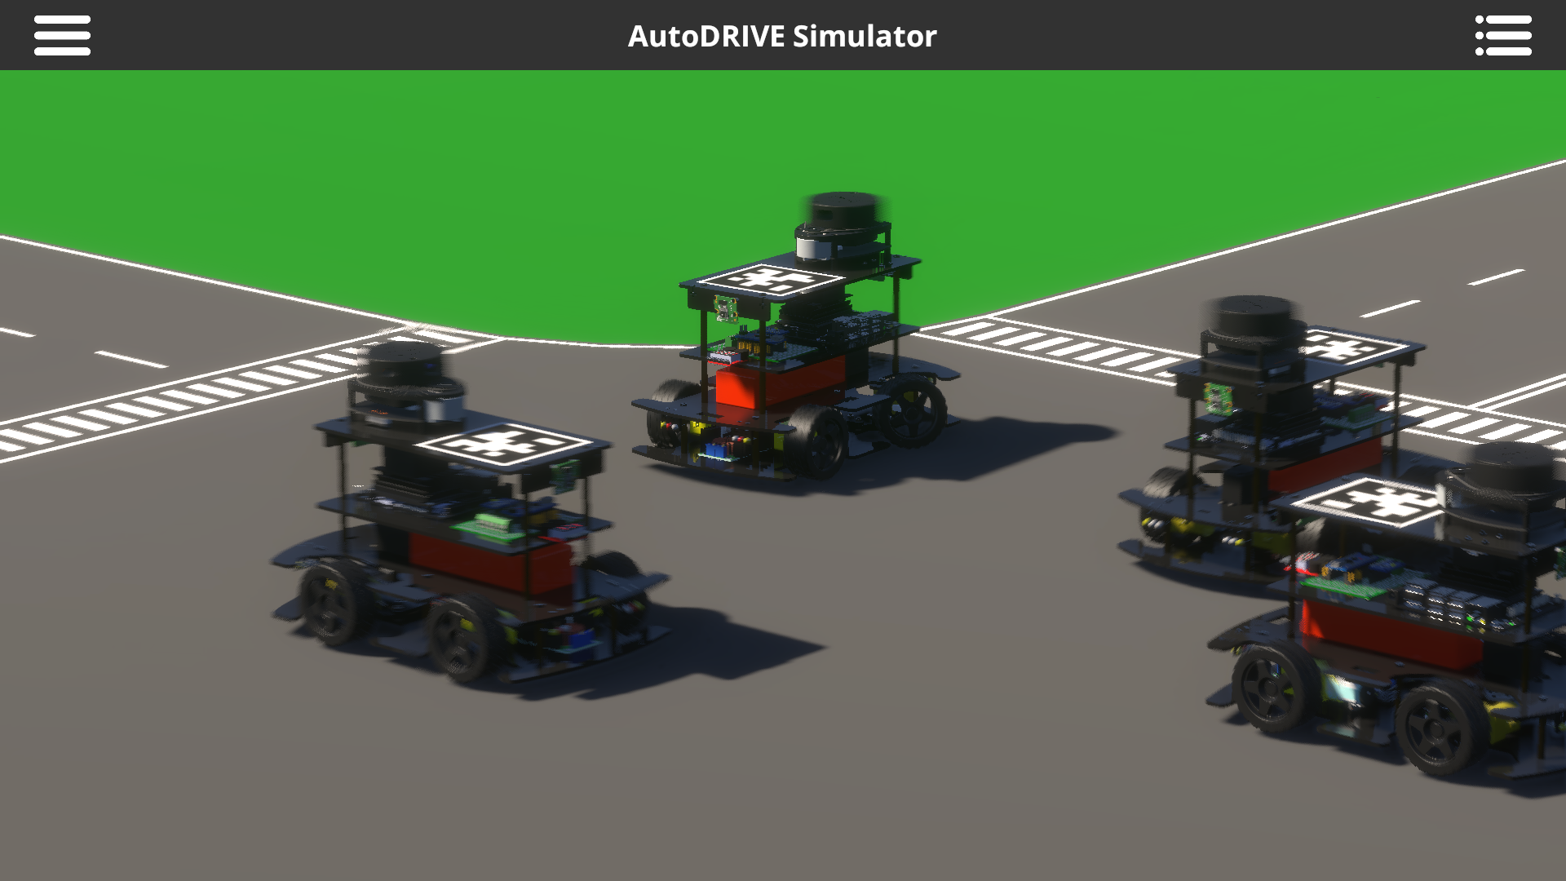
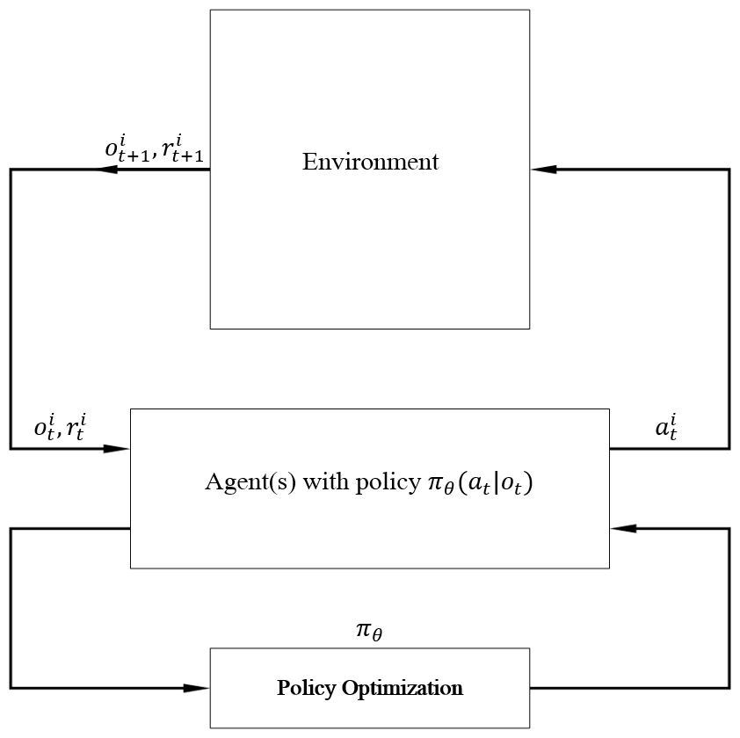
Multi-Agent Reinforcement Learning
Reinforcement learning
Learning through experience
Multi-agent reinforcement learning
Complex and dynamic interactions
Cooperative and competitive scenarios
Autonomous vehicles
Cooperation: autonomous driving
Competition: autonomous racing
Coopertition: cooperation and competition

Slide 7
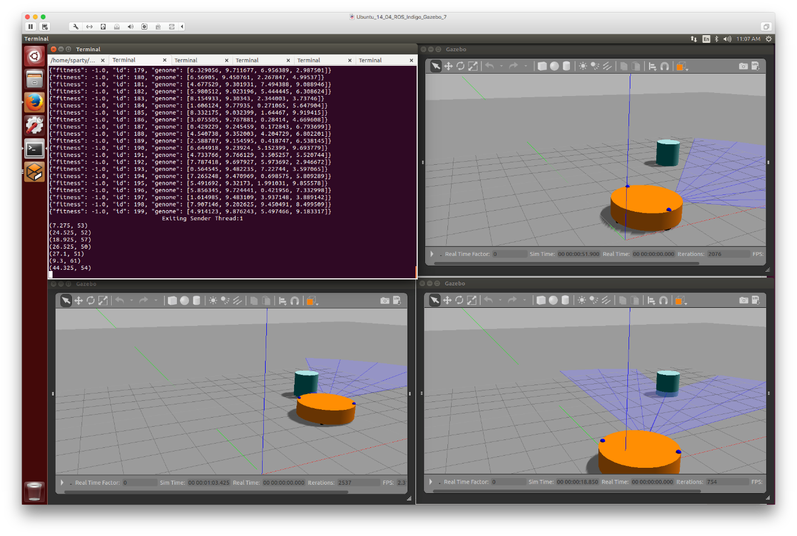
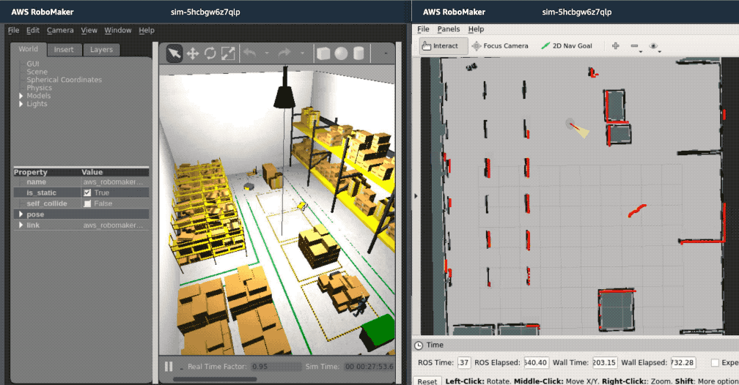
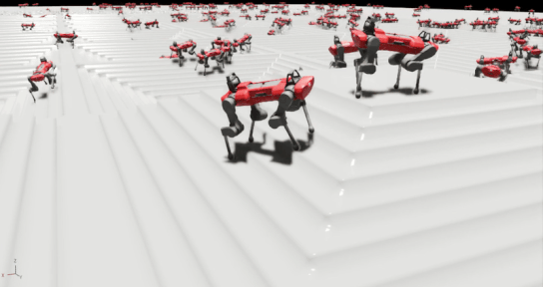
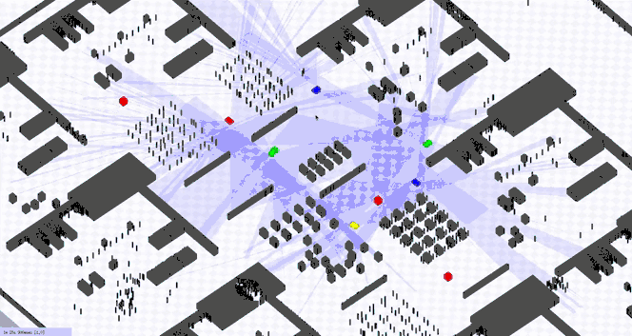
Simulation Parallelization
Existing approaches
Multiple simulation instances
Multiple robots in single simulation instance
Challenges
Unnecessary computational overhead
Exteroceptive perception modalities
Ideal approaches
Parallelize only what is required
Environment parallelization
Agent parallelization

Slide 8
Literature Survey
Multi-Agent Reinforcement Learning

Slide 9
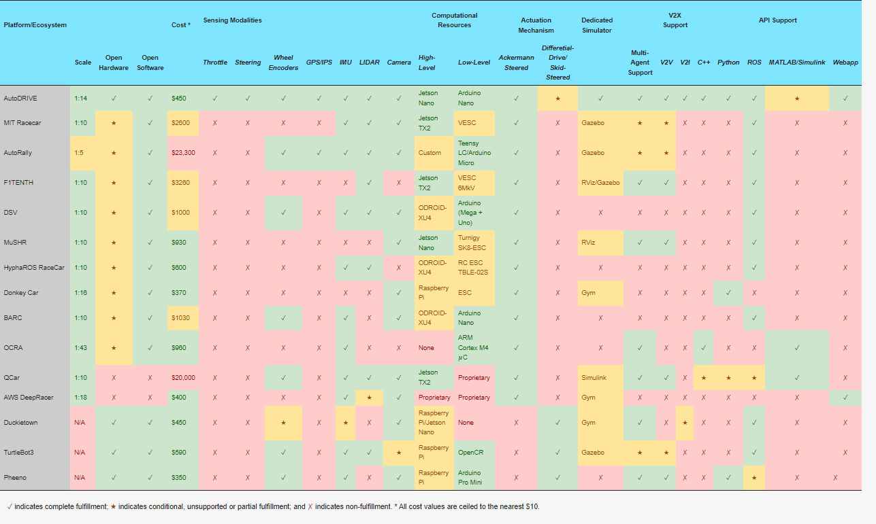
Comparative Analysis of Hardware Platforms
T. Samak, C. Samak, S. Kandhasamy, V. Krovi, and M. Xie, “AutoDRIVE: A Comprehensive, Flexible and Integrated Digital Twin Ecosystem for Autonomous Driving Research & Education,” Robotics, vol. 12, no. 3, p. 77, May 2023, doi: https://doi.org/10.3390/robotics12030077

Slide 10
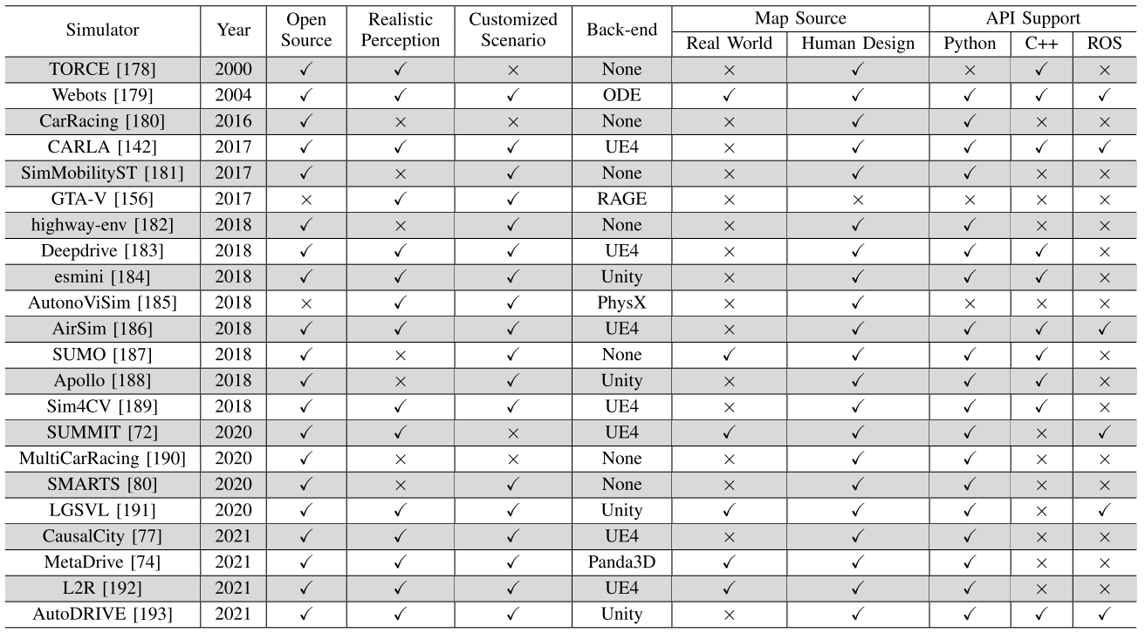
Comparative Analysis of Simulation Platforms
W. Ding, C. Xu, M. Arief, H. Lin, B. Li and D. Zhao, “A Survey on Safety-Critical Driving Scenario Generation—A Methodological Perspective,” in IEEE Transactions on Intelligent Transportation Systems, vol. 24, no. 7, pp. 6971-6988, July 2023, doi: 10.1109/TITS.2023.3259322

Slide 11




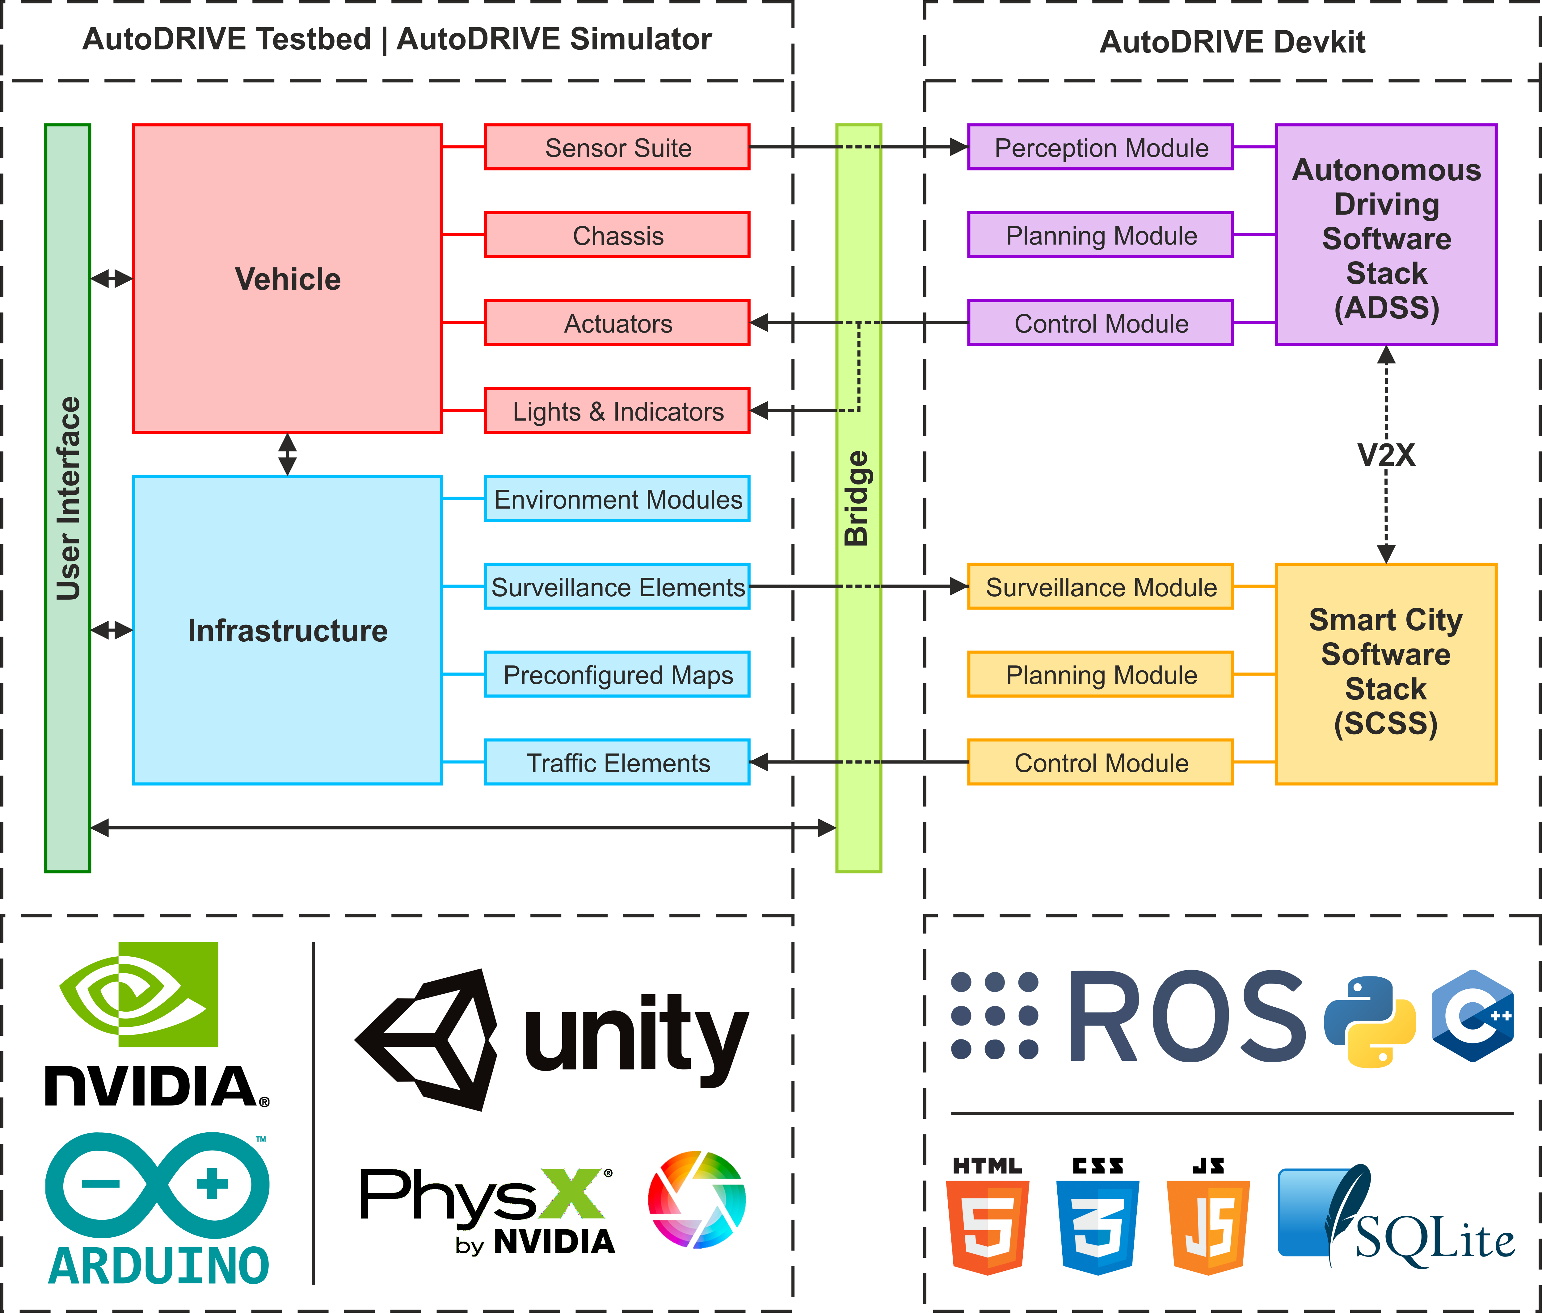
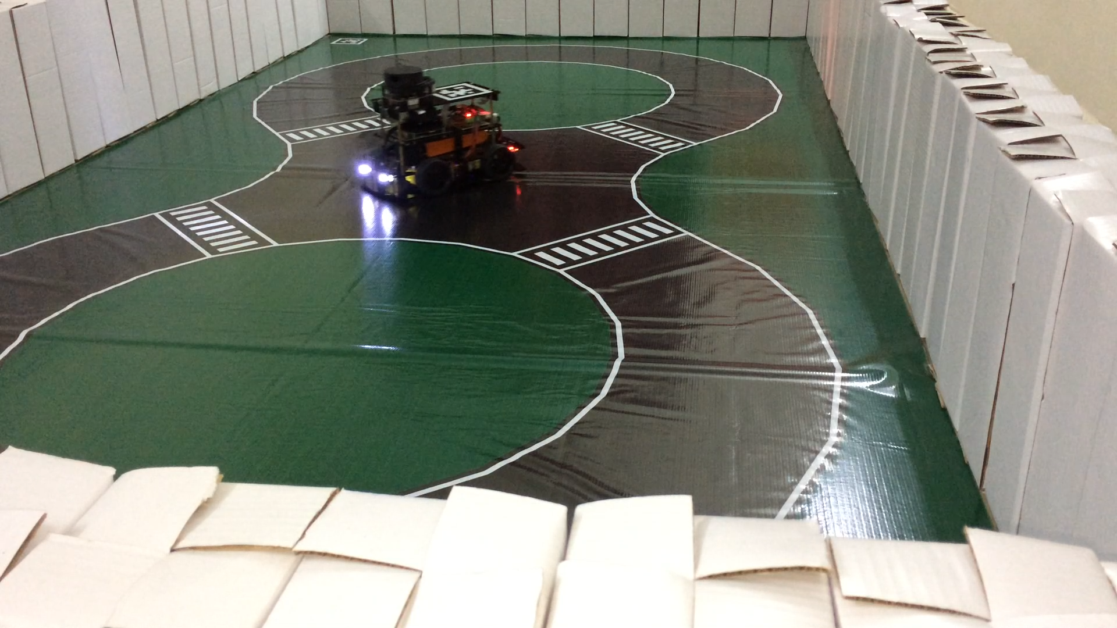
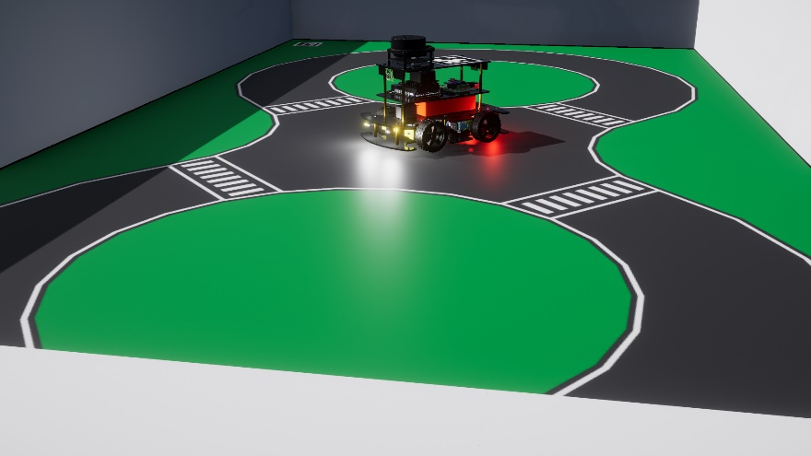
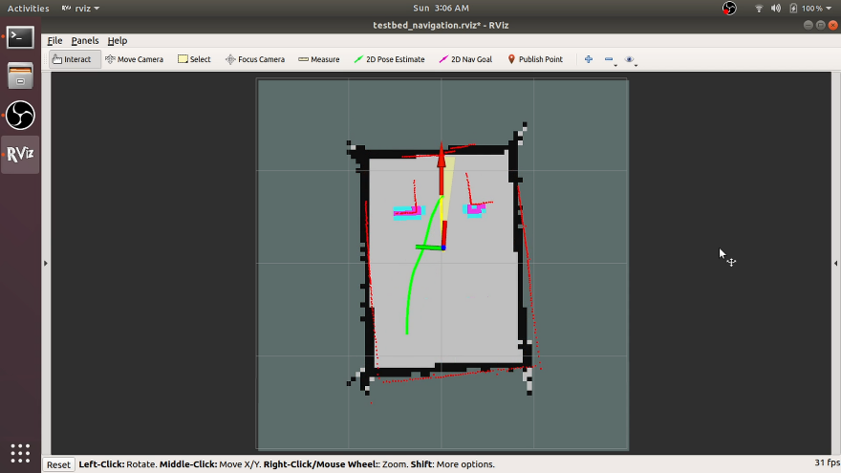
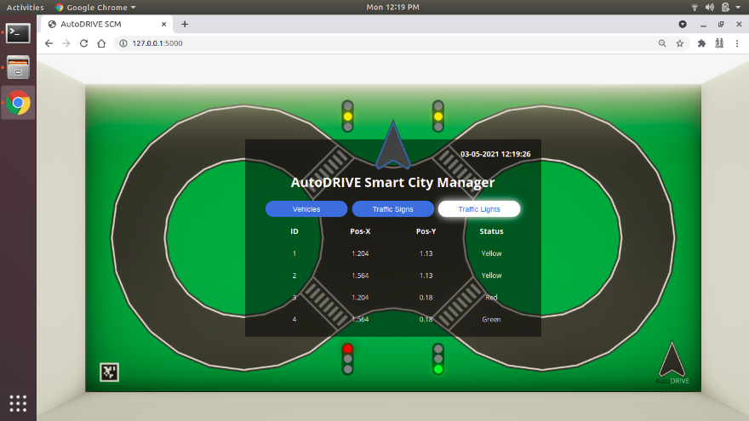

AutoDRIVE Ecosystem
Source: https://autodrive-ecosystem.github.io
Develop autonomy algorithms using flexible APIs
Simulate for initial prototyping and corner-case analysis
Deploy on mechatronic testbed for real-world validation
Small, mid and full-scale vehicles and infrastructure
Autonomous driving + smart-city applications
Affordable cost and completely open-source
Resources:
Website
Paper
GitHub
YouTube
Vehicle | Mobile Base | Battery | Computer(s) | Sensor(s) | Actuator(s) | Developer | Release | Cost
Nigel | Open-Source | 5200 mAh | Jetson Nano or Jetson Orin Nano | RPLIDAR A-1, Pi-Cameras, Intel RealSense D435i, 9-Axis IMU, 6-Axis IPS, Encoders, Microphone, Steering Feedback, Throttle Feedback | DC Motors, Steering Servo(s) | CU-ICAR + NTU + SRMIST | 2021 | $450
Simulation Quality | Physics Engine | Graphics Rendering | Vehicle Dynamics Support | Sensor Support | API Support | Developer | Cost | Open Source | Applications
3D | PhysX | Unity HDRP | Full car model for lateral, longitudinal, vertical and RPY dynamics with tire-terrain interaction | 2D/3D LIDAR, Camera, GNSS, IPS, IMU, Encoders Steering Feedback, Throttle Feedback, State Variables | ROS, ROS 2, Python, C++, MATLAB, Simulink, Webapp | CU-ICAR, NTU, SRMIST | Free | Yes | Exploration, education and research
=

Slide 12
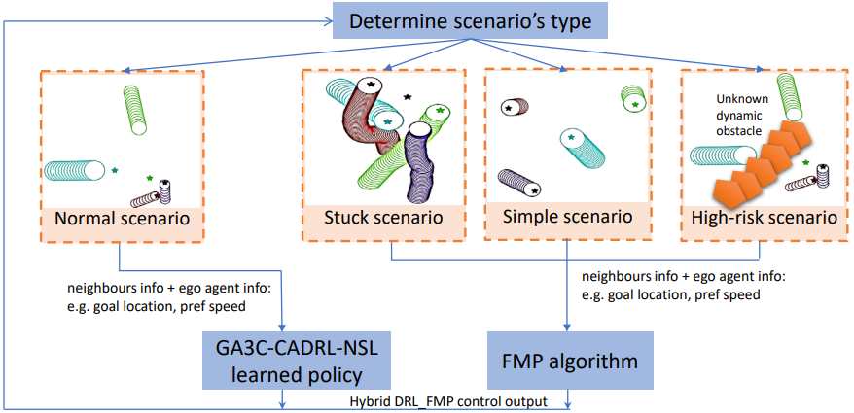
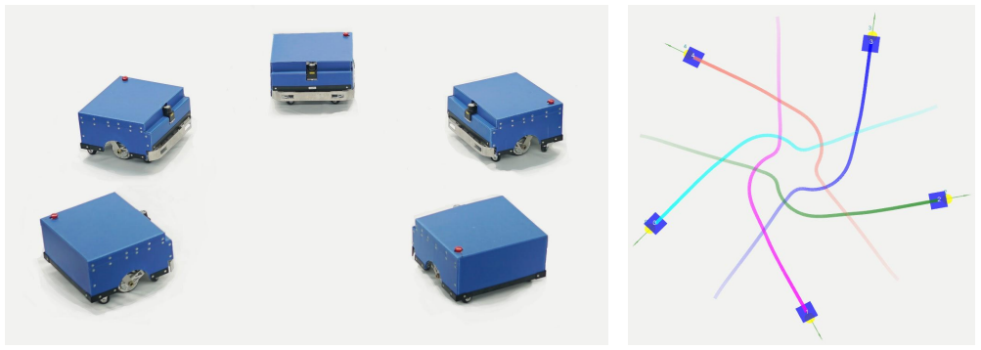
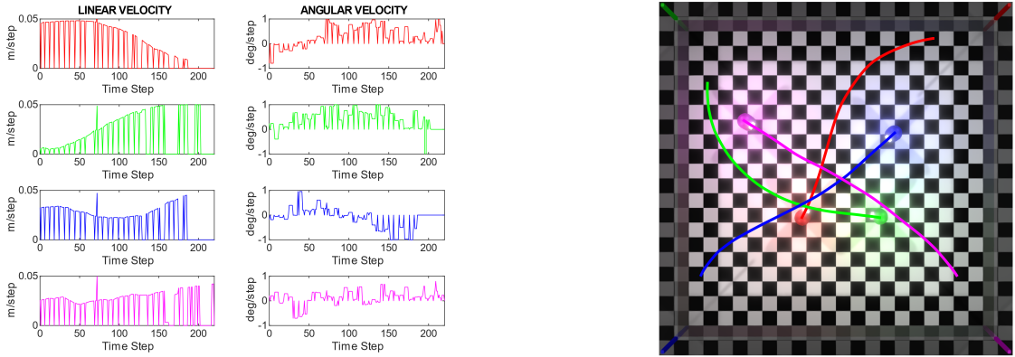
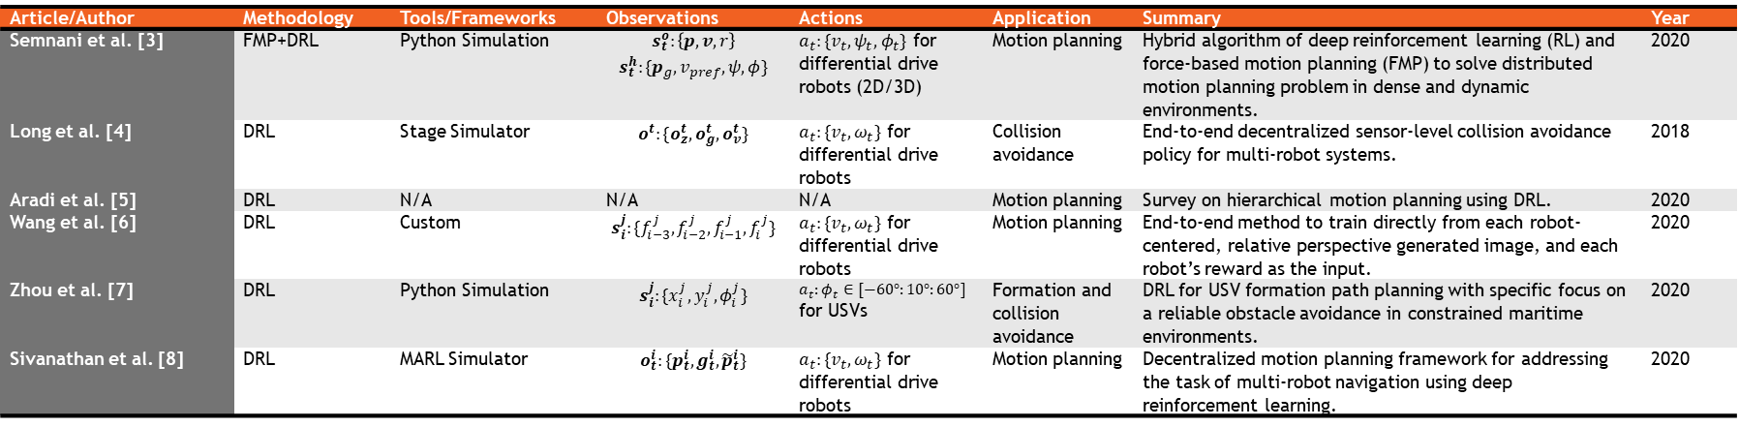
State-of-the-Art: Cooperative DRL
Article/Author | Methodology | Tools/Frameworks | Observations | Actions | Application | Summary | Year
Semnani et al. [3] | FMP+DRL | Python Simulation | $$s_{t}^{o}:\left\{p, v, r\right\}$$ $$s_{t}^{h}:\{p_{g}, v_{pref}, ψ,φ\}$$ | $a_{t}:\{v_{t},ψ_{t},φ_{t}\}$ for differential drive robots (2D/3D) | Motion planning | Hybrid algorithm of deep reinforcement learning (RL) and force-based motion planning (FMP) to solve distributed motion planning problem in dense and dynamic environments. | 2020
Long et al. [4] | DRL | Stage Simulator | $$o^{t}:\{o_{z}^{t},o_{g}^{t},o_{v}^{t}\}$$ | $a_{t}:\{v_{t},ω_{t}\}$ for differential drive robots | Collision avoidance | End-to-end decentralized sensor-level collision avoidance policy for multi-robot systems. | 2018
Aradi et al. [5] | DRL | N/A | N/A | N/A | Motion planning | Survey on hierarchical motion planning using DRL. | 2020
Wang et al. [6] | DRL | Custom | $$s_{i}^{j}:\{f_{i−3}^{j},f_{i−2}^{j},f_{i−1}^{j},f_{i}^{j}\}$$ | $a_{t}:\{v_{t},ω_{t}\}$ for differential drive robots | Motion planning | End-to-end method to train directly from each robot-centered, relative perspective generated image, and each robot’s reward as the input. | 2020
Zhou et al. [7] | DRL | Python Simulation | $$s_{i}^{j}:\{x_{i}^{j},y_{i}^{j},φ_{i}^{j}\}$$ | $a_{t}:φ_{t}∈[−60°:10°:60°]$ for USVs | Formation and collision avoidance | DRL for USV formation path planning with specific focus on a reliable obstacle avoidance in constrained maritime environments. | 2020
Sivanathan et al. [8] | DRL | MARL Simulator | $$o_{t}^{i}:\{p_{t}^{i},g_{t}^{i},{\tilde{p}}_{t}^{i}\}$$ | $a_{t}:\{v_{t},ω_{t}\}$ for differential drive robots | Motion planning | Decentralized motion planning framework for addressing the task of multi-robot navigation using deep reinforcement learning. | 2020
DRL-FMP hybrid control framework [3]
Collision avoidance using DRL [4]
Decentralized motion planning using DRL [8]

Slide 13
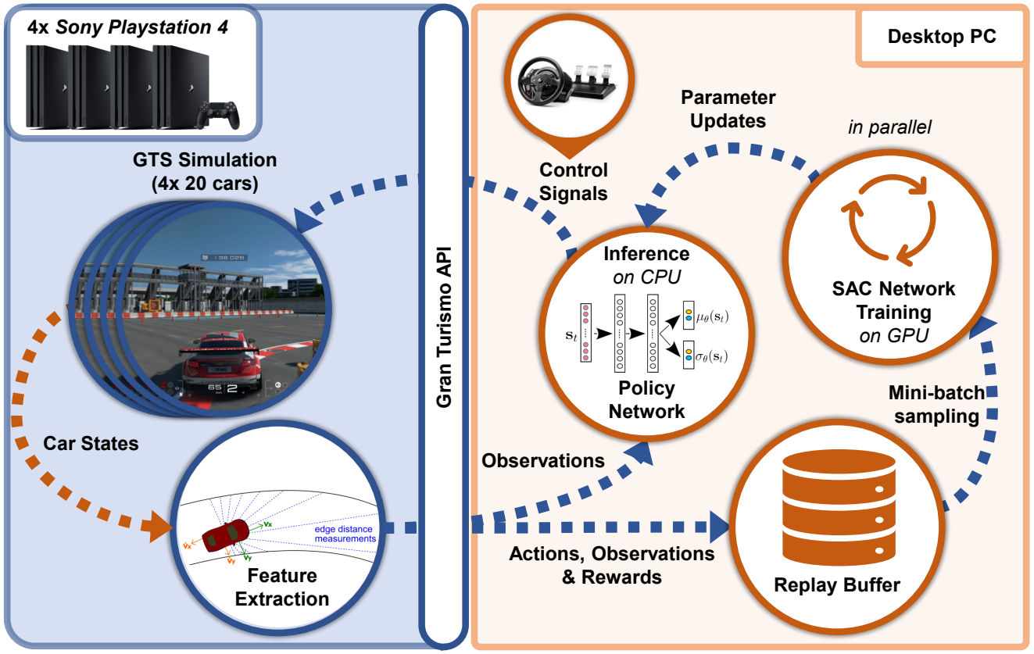
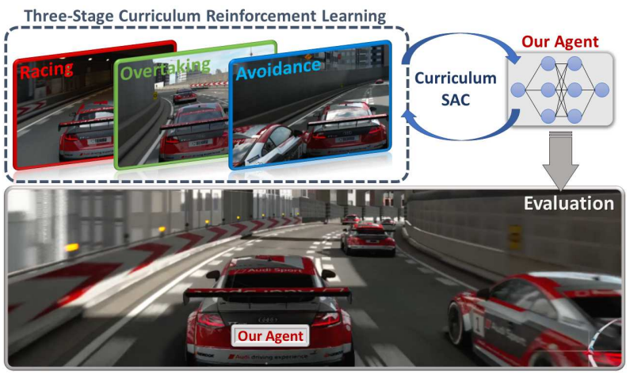
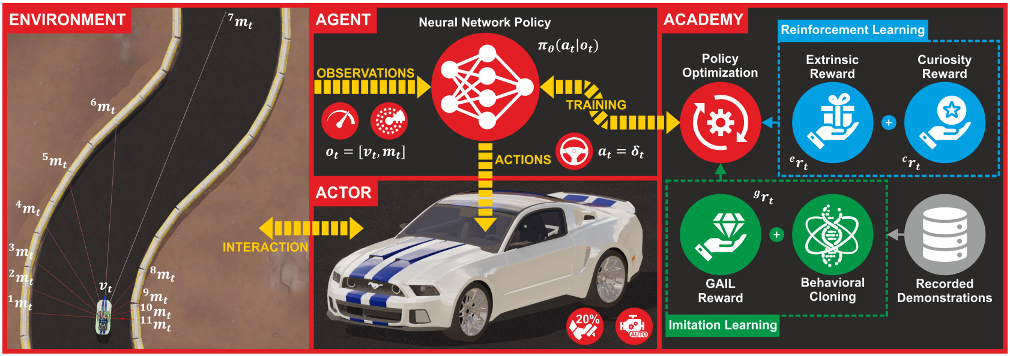
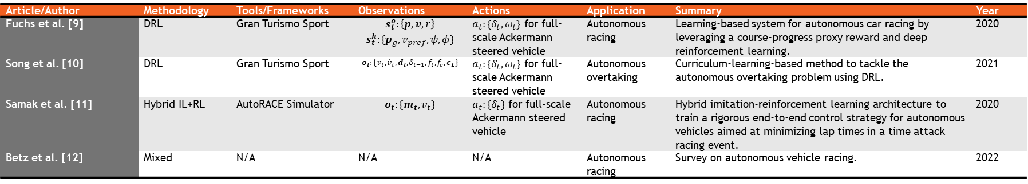
State-of-the-Art: Competitive DRL
Article/Author | Methodology | Tools/Frameworks | Observations | Actions | Application | Summary | Year
Fuchs et al. [9] | DRL | Gran Turismo Sport | $$s_{t}^{o}:\left\{p, v, r\right\}$$ $$s_{t}^{h}:\{p_{g}, v_{pref}, ψ,φ\}$$ | $a_{t}:\{δ_{t},ω_{t}\}$ for full-scale Ackermann steered vehicle | Autonomous racing | Learning-based system for autonomous car racing by leveraging a course-progress proxy reward and deep reinforcement learning. | 2020
Song et al. [10] | DRL | Gran Turismo Sport | $$o_{t}:\{v_{t},{\dot{v}}_{t},d_{t},δ_{t−1},f_{t},f_{c}, c_{L}\}$$ | $a_{t}:\{δ_{t},ω_{t}\}$ for full-scale Ackermann steered vehicle | Autonomous overtaking | Curriculum-learning-based method to tackle the autonomous overtaking problem using DRL. | 2021
Samak et al. [11] | Hybrid IL+RL | AutoRACE Simulator | $$o_{t}:\{m_{t}, v_{t}\}$$ | $a_{t}:\{δ_{t}\}$ for full-scale Ackermann steered vehicle | Autonomous racing | Hybrid imitation-reinforcement learning architecture to train a rigorous end-to-end control strategy for autonomous vehicles aimed at minimizing lap times in a time attack racing event. | 2020
Betz et al. [12] | Mixed | N/A | N/A | N/A | Autonomous racing | Survey on autonomous vehicle racing. | 2022
DRL-FMP hybrid control framework [9]
Autonomous overtaking using DRL [10]
Hybrid IL+RL architecture for autonomous racing [11]

Slide 14
Digital Twin Creation
Physically and Graphically Accurate Digital Twins

Slide 15
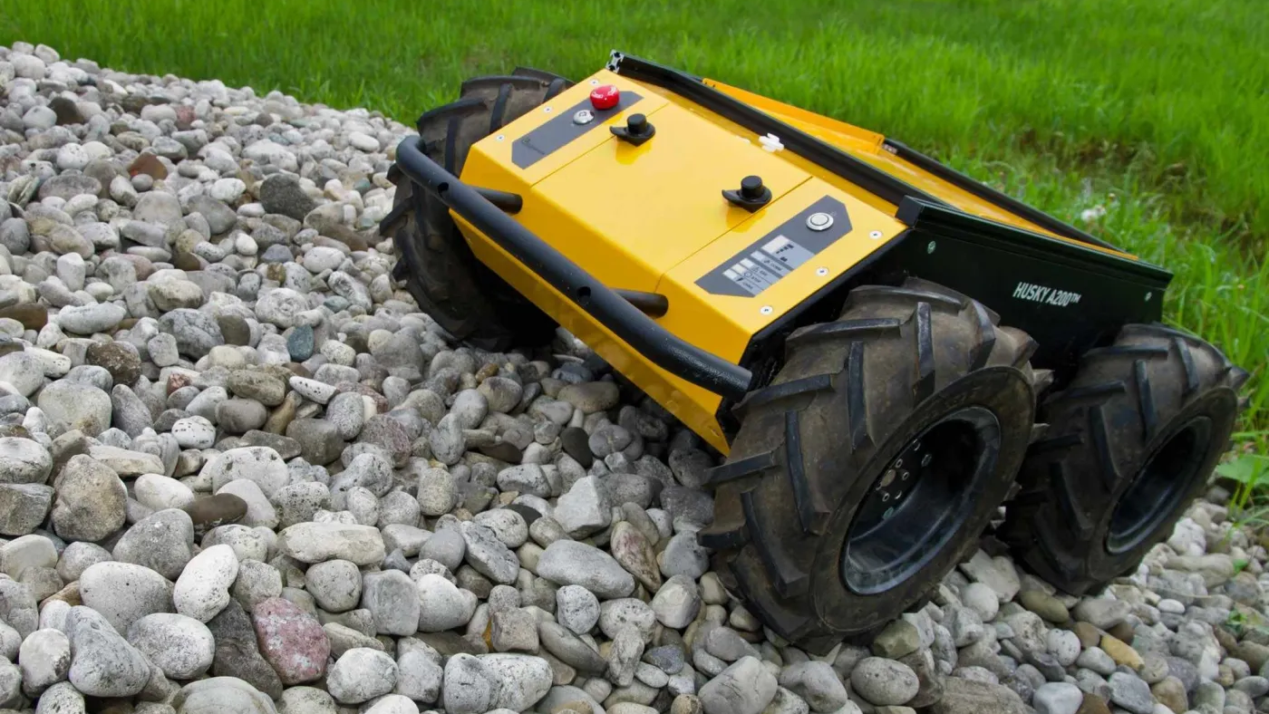
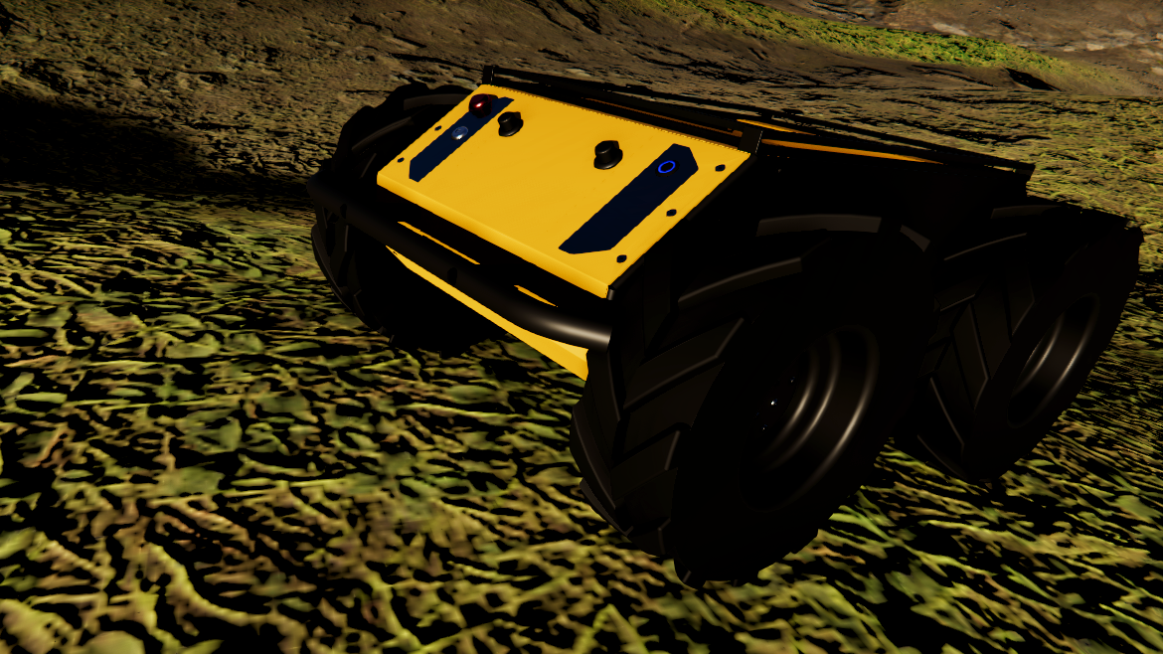
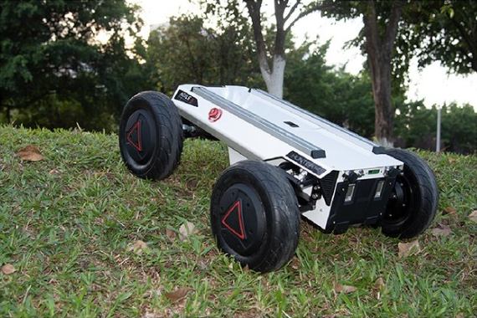
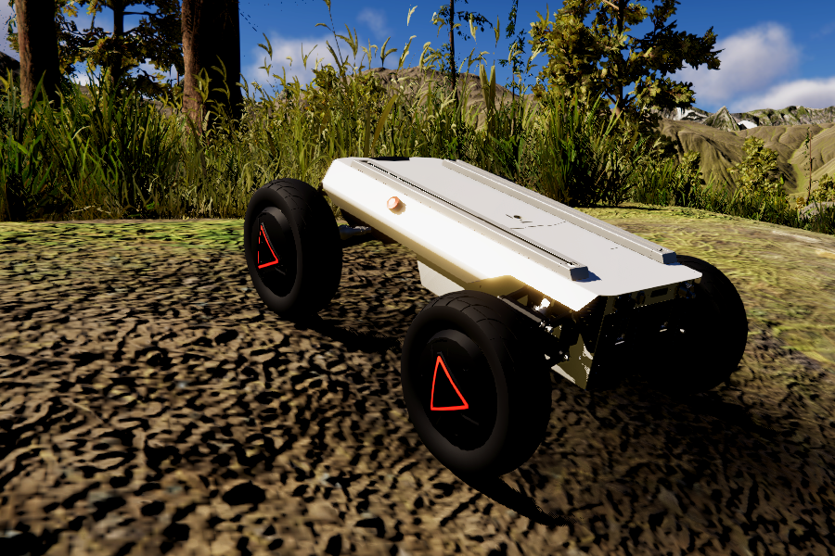
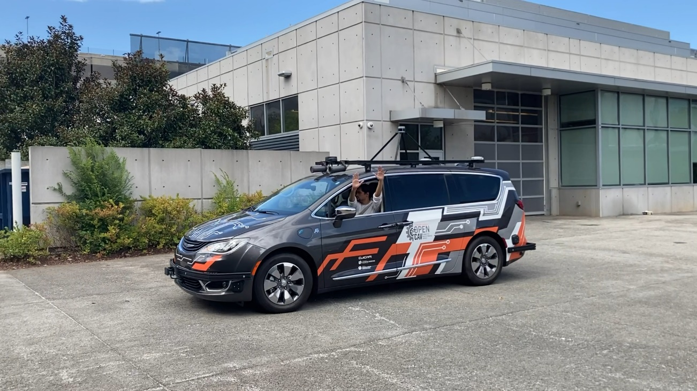
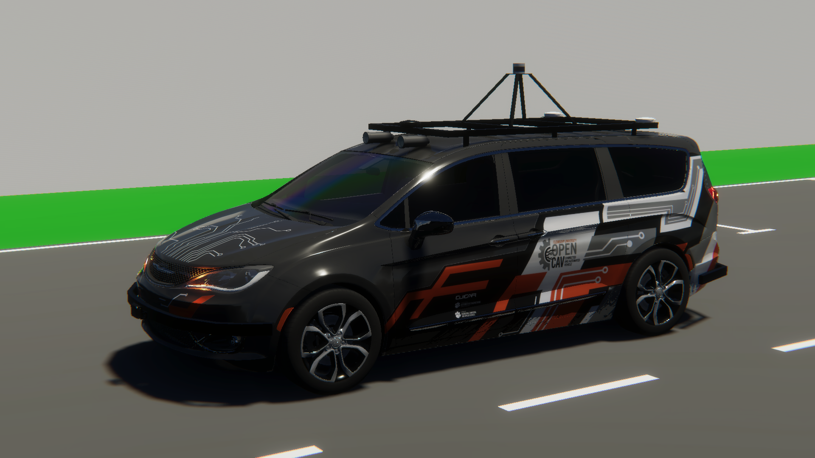
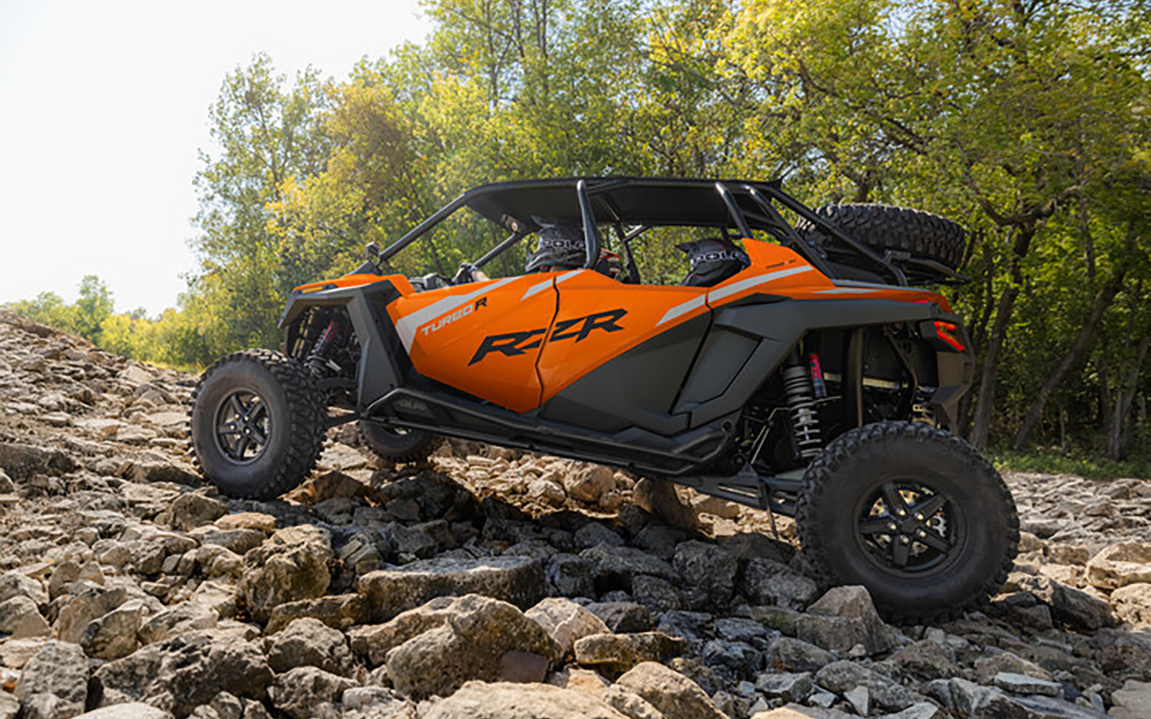
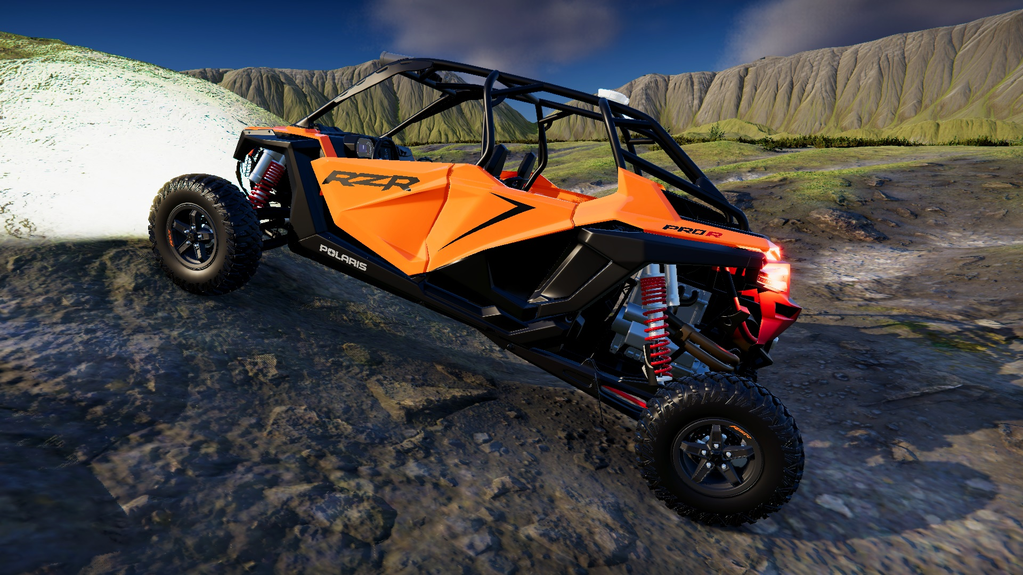
Digital Twin Capabilities of AutoDRIVE Ecosystem
SMALL-SCALE
Nigel (Native Vehicle)
F1TENTH (1/10th Scale Racecar)
MID-SCALE
Husky (On/Off-Road Skid-Steer Robot)
Hunter SE (On/Off-Road Ackermann Steered Vehicle)
FULL-SCALE
OpenCAV (On-Road Commercial Vehicle)
RZR (Recreational Off-Highway Vehicle)
Source: AutoDRIVE Ecosystem

Slide 16
Digital Twins of Nigel and F1TENTH
Nigel
1:14 scale
Autonomous driving
F1TENTH
1:10 scale
Autonomous racing
Digital twinning
Dynamics interface
Perception interface

Slide 17
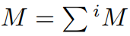
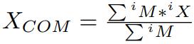
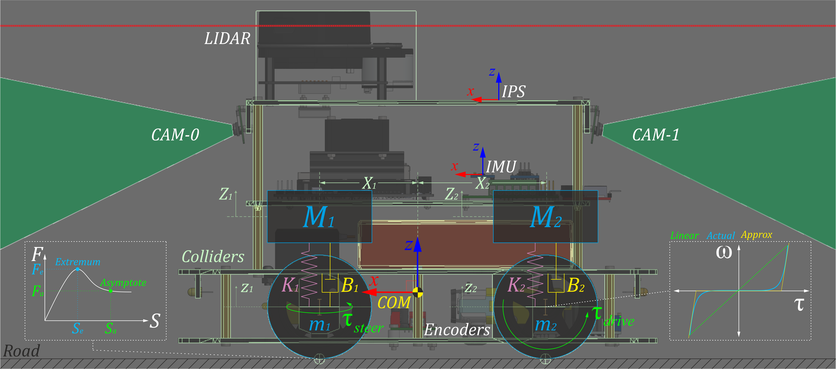
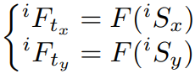
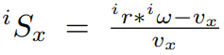
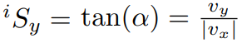
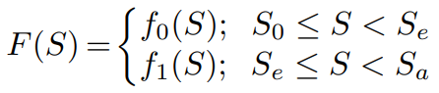
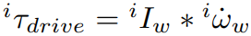
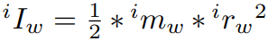
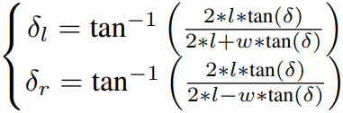
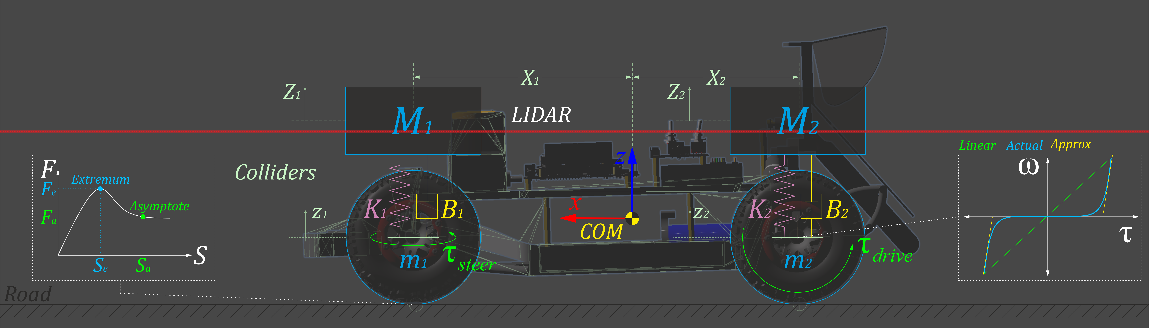
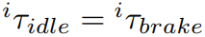
Digital Twins: Dynamics Interface
Rigid-body dynamics
Suspension dynamics
Tire dynamics
Actuator dynamics

Slide 18
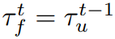
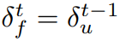
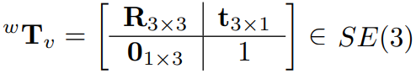
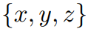











Digital Twins: Perception Interface
Throttle sensor
Steering sensor
Indoor positioning system
Inertial measurement unit
Incremental encoders
LIDAR
Cameras

Slide 19
Competitive MARL Case Study
Head-to-Head Autonomous Racing

Slide 20











Problem Formulation
POMDP
No state-sharing
Observation space
Own velocity
Sparse LIDAR measurements
Action space
Discrete throttle
Discrete steering
Reward formulation
Collision
Checkpoints (19 virtual ckpts)
Lap completion (1 virtual ckpt)
Best time
Velocity

Slide 21






MARL Training
Training hardware
Dell Alienware x15 R2 Laptop PC
CPU: 12th Gen Intel Core i9-12900H 2.50 GHz
RAM: 32.0 GB (31.7 GB usable)
GPU: NVIDIA GeForce RTX 3080 Ti (Laptop GPU)
Training time
4.21 hours (SOTA: >72 hours with better compute [9])
Training analysis
BC Loss
GAIL reward
Curiosity reward
Extrinsic reward
Episode length
Policy entropy

Slide 22


MARL Deployment
Block-Block-Overtake
Let-Pass-and-Overtake

Slide 23


Simulation Parallelization
Parallel MARL [Ongoing]
1 environment
10x2 agents
Scalable parallelization architecture
Object oriented programming (OOP)
Multi-threading and GPU instancing
Isolation in different “layers” of simulation
Environment on “default” layer
Each family of multi-agent system on same layer
Parallel sensors
Interoceptive sensors have little to no issue in parallelizing
Camera: rendering culling mask only for specific layers
LIDAR: raycasting returns hit only for specific layers
Parallel collisions and interactions
Interactions and collision checks between specific layers

Slide 24
Project Progress
Completed and Ongoing Efforts

Slide 25


Project Progress
Set up high-fidelity 3D simulation platform based on real-world vehicle/environment representations (real2sim transfer) [Tanmay]
Set up modular and scalable simulation framework using object oriented programming (OOP) [Chinmay]
Set up intelligent agent/environment parallelization framework for accelerating RL training [Tanmay]
Formulate multi-agent reinforcement learning (MARL) problems for: [Tanmay]
Cooperative MARL (e.g., safe intersection traversal)
Competitive MARL (e.g., head-to-head autonomous racing)
Implement the formulated deep reinforcement learning (DRL) pipeline and conduct parallelized training using local/cloud high-performance computing (HPC) resources [Chinmay]
Deploy and analyze the trained policies and procedures to comment on the aspects of “computing and simulation for autonomy” [Chinmay]
Note: The name in square bracket indicates primary responsibility and NOT contribution. Both members will work together and contribute equally to this project.

Slide 26
Thank You!
…open to questions and suggestions

Slide 27
References
T. Samak, C. Samak, S. Kandhasamy, V. Krovi, and M. Xie, “AutoDRIVE: A Comprehensive, Flexible and Integrated Digital Twin Ecosystem for Autonomous Driving Research & Education,” Robotics, vol. 12, no. 3, p. 77, May 2023, doi: 10.3390/robotics12030077
W. Ding, C. Xu, M. Arief, H. Lin, B. Li and D. Zhao, “A Survey on Safety-Critical Driving Scenario Generation—A Methodological Perspective,” in IEEE Transactions on Intelligent Transportation Systems, vol. 24, no. 7, pp. 6971-6988, July 2023, doi: 10.1109/TITS.2023.3259322
S. H. Semnani, H. Liu, M. Everett, A. de Ruiter, and J. P. How, “Multiagent Motion Planning for Dense and Dynamic Environments via Deep Reinforcement Learning,” 2020.
P. Long, T. Fan, X. Liao, W. Liu, H. Zhang, and J. Pan, “Towards Optimally Decentralized Multi-Robot Collision Avoidance via Deep Reinforcement Learning,” 2018
S. Aradi, “Survey of Deep Reinforcement Learning for Motion Planning of Autonomous Vehicles,” 2020.
D. Wang, H. Deng, and Z. Pan, “MRCDRL: Multi-Robot Coordination with Deep Reinforcement Learning,” Neurocomputing, 2020.
X. Zhou, P. Wu, H. Zhang, W. Guo, and Y. Liu, “Learn to navigate: cooperative path planning for unmanned surface vehicles using deep reinforcement learning,” IEEE Access, vol. 7, pp. 165 262–165 278, 2019.

Slide 28
References
K. Sivanathan, B. K. Vinayagam, T. Samak, and C. Samak, “Decentralized Motion Planning for Multi-Robot Navigation using Deep Reinforcement Learning,” in 2020 3rd International Conference on Intelligent Sustainable Systems (ICISS), 2020, pp. 709–716, doi: 10.1109/ICISS49785.2020.9316033
F. Fuchs, Y. Song, E. Kaufmann, D. Scaramuzza, and P. Durr, “Super-Human Performance in Gran Turismo Sport Using Deep Reinforcement Learning,” IEEE Robotics and Automation Letters, vol. 6, no. 3, pp. 4257–4264, 2021.
Y. Song, H. Lin, E. Kaufmann, P. Durr, and D. Scaramuzza, “Autonomous Overtaking in Gran Turismo Sport Using Curriculum Reinforcement Learning,” 2021.
C. V. Samak, T. V. Samak, and S. Kandhasamy, “Autonomous Racing using a Hybrid Imitation-Reinforcement Learning Architecture,” 2021. [Online]. Available: https://arxiv.org/abs/2110.05437
J. Betz, H. Zheng, A. Liniger, U. Rosolia, P. Karle, M. Behl, V. Krovi, and R. Mangharam, “Autonomous Vehicles on the Edge: A Survey on Autonomous Vehicle Racing,” IEEE Open Journal of Intelligent Transportation Systems, vol. 3, pp. 458–488, 2022.

